Slide 1
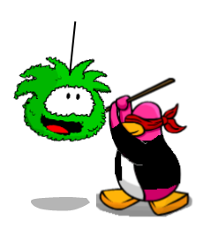
Club Penguin
An awesome place!

Slide 2
What is club penguin?
Club Penguin is an online world where you can adopt a cute little penguin. You have a igloo for him to live in and you can buy him a puffle.

Slide 3
Puffle?????
Puffles are little colorful puff balls that you can adopt as a pet. There are blue,red,yellow,black,purple, and other colored puffles. They each have their own unique personality.

Slide 4
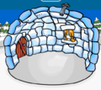
Your Igloo
Design how you want
Upgrade it
Add furniture
Throw parties in it
Play music in it

Slide 5
Membership
With a membership you can buy furniture,clothes,upgrade your igloo and all that good stuff. Memberships can last from 1 month-12 months.

Slide 6
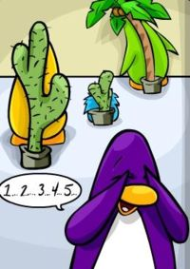
Go to Club Penguin Today!
For more info go to:
http://clubpenguin.wikia.com/wiki/Club_Penguin_Wiki

